Slide 1
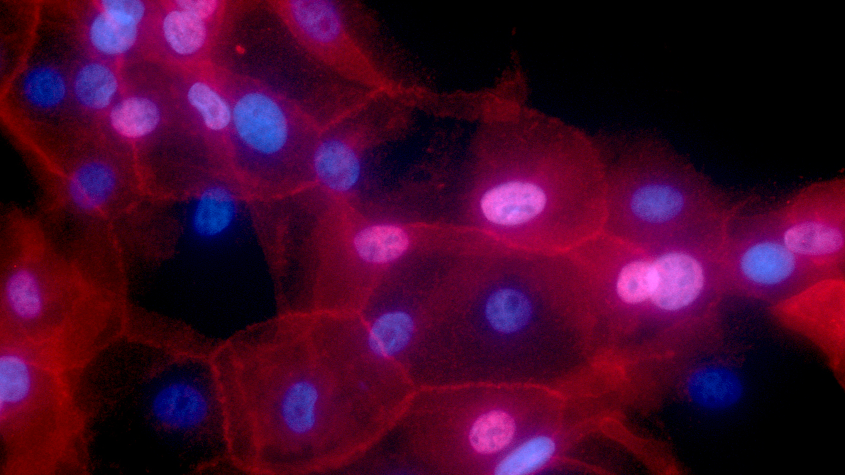
Liquid biopsies as a tool for monitoring canine mammary carcinomas
Sophie Agger, PhD student
Supervisors:
Associate professor Maja Arendt, DVM, PhD, DipECVIM-CA(onc)
Professor Kerstin Lindblad-Toh, PhD Professor Annemarie T. Kristensen, DVM, PhD, DACVIM-SA, DipECVIM-CA, DipECVIM-CA(onc)
Credit: Ewa Krawczyk, National Cancer Institute \ Georgetown Lombardi Comprehensive Cancer Center, National Institutes of Health
Notes:
The image shows cell culture of human breast cancer conditionally reprogrammed cells. Fluorescence red color represents MHC-I, and nuclei are shown in blue.

Slide 2
Background
Dogs are good models as they develop cancer spontaneously unlike rodent models
Many similarities in disease course but accelerated in dogs
Translational value diminished by different diagnostic schemes
Canine mammary tumors can be both benign and malignant unlike breast cancer
I will be focusing on malignant mammary tumors (carcinomas)/breast cancer
Notes:
Breast cancer prognosis is described based on ER/PR/HER2 receptor status as well as histiological grading
Visualization of the enormous degree of chromosomal instability in primary breast cancers using fluorescence in situ hybridization to identify copy number changes of specific chromosomes and oncogenes.

Slide 3
Clinical challenges Staging
Axillary lymph node
Inguinal lymph node
Lymph drainage of mammary tissue in the bitch
ax: axillary lymph nodes in: inguinal lymph nodes
st: sternal lymph nodes mi: medial iliac lymph nodes pl: popliteal lymph nodes
Notes:
Staging
Why does it matter?
When treating cancer the treament dose is important – that means how much to remove and whether or not to follow up with other therapy such as chemotherapy.
In order to decide on treatment, you need to know where the cancer is. If it has spread to lymph nodes, it will not be sufficient to remove the tumor. However this is complicated by several factors. One is that the metastasis need to be present where we look and have a certain size.
For lymph nodes we have 2 main issues. The unpredictable drainage pattern – and size/placement of lymph nodes and the number of metastatic cells. Even if you find the correct lymph node, you might still miss the cancer cells.
For distant metastasis the issue is mostly an issue of size of metastasis, a few cells won’t show up on a CT.
Treatment dose
Surgical dose
Adjuvant therapy

Slide 4
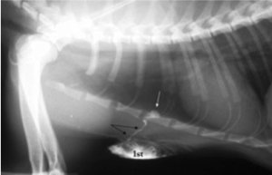
Clinical challenges Staging
Notes:
Staging
Why does it matter?
When treating cancer the treament dose is important – that means how much to remove and whether or not to follow up with other therapy such as chemotherapy.
In order to decide on treatment, you need to know where the cancer is. If it has spread to lymph nodes, it will not be sufficient to remove the tumor. However this is complicated by several factors. One is that the metastasis need to be present where we look and have a certain size.
For lymph nodes we have 2 main issues. The unpredictable drainage pattern – and size/placement of lymph nodes and the number of metastatic cells. Even if you find the correct lymph node, you might still miss the cancer cells.
For distant metastasis the issue is mostly an issue of size of metastasis, a few cells won’t show up on a CT.

Slide 5
Clinical challenges Treatment
Treatment plan based on prognostic factors
Aim: Minimize under- and overtreatment
Current tools insensitive
Better tools are needed!
Notes:
The issue is to find the balance between treating enough and minimizing adverse effects, and although there are guidelines it’s an educated guess most of the time based on prognostic factors. F.ex metastasis to lymph nodes, size and receptor status. However, sometimes the guess is wrong. Some small tumors will have spread regardless of risk factors and some large, aggressive looking tumors can be cured with simple surgery.
This leads to 2 different issues, some patients will receive needless adjuvant therapy and have unneeded adverse effects and some people will not receive curative treatment. Unneeded chemo might seem trivial, but some people will end up having permanent nerve damage and pain which has a huge impact on quality of life.

Slide 6
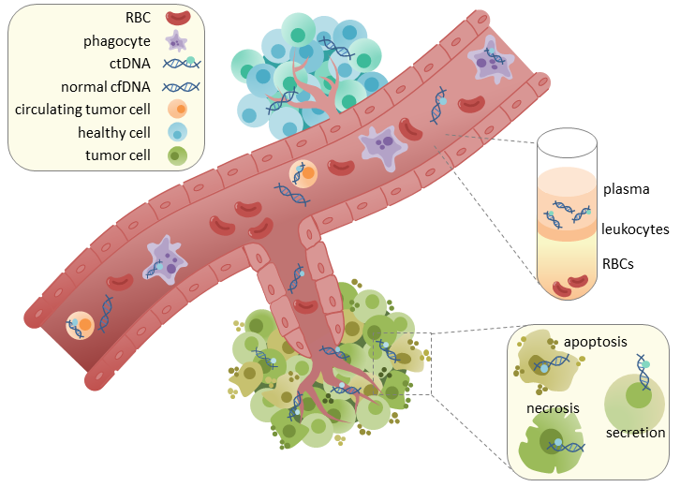
Cell-free DNA
Tumor
Notes:
Every time a cell dies some amount of DNA will be released, this amount is increased in tumors, due to increased rate of necrosis, hypoxia, unstable cells etc.
This tumor DNA will contain the variations found in the cancer cells and due to a very short half-life (some say less than 2 hours) it can be used as reliable marker for presence of tumor cells. So the idea is that you remove the tumor and mutations specific to the tumor is present in the cfDNA you know that there’s tumor cells left behind and adjuvant treatment is needed. Of course a certain tumor burden is needed before it’s detectable, but it should be more sensitive than the current modalities such as CT. It can also be used as a long-term follow up modality. Instead of having to do mammograms, CT’s and fine-needle aspirates, you can monitor the peripheral blood for tumor specific mutations and react earlier to any sign of relapse (due to the modality being more sensitive) especially if the metastasis is diffuse or internal.
Nogen siger 50 mio maligne celler er nok til at give målbar ctDNA

Slide 7
Cell-free DNA
Tumor
Notes:
Every time a cell dies some amount of DNA will be released, this amount is increased in tumors, due to increased rate of necrosis, hypoxia, unstable cells etc.
This tumor DNA will contain the variations found in the cancer cells and due to a very short half-life (some say less than 2 hours) it can be used as reliable marker for presence of tumor cells. So the idea is that you remove the tumor and mutations specific to the tumor is present in the cfDNA you know that there’s tumor cells left behind and adjuvant treatment is needed. Of course a certain tumor burden is needed before it’s detectable, but it should be more sensitive than the current modalities such as CT. It can also be used as a long-term follow up modality. Instead of having to do mammograms, CT’s and fine-needle aspirates, you can monitor the peripheral blood for tumor specific mutations and react earlier to any sign of relapse (due to the modality being more sensitive) especially if the metastasis is diffuse or internal.
Nogen siger 50 mio maligne celler er nok til at givve målbar ctDNA

Slide 8
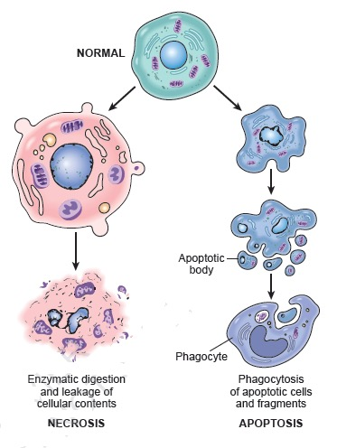
Circulating tumor DNA
Notes:
Every time a cell dies some amount of DNA will be released, this amount is increased in tumors, due to increased rate of necrosis, hypoxia, unstable cells etc.
This tumor DNA will contain the variations found in the cancer cells and due to a very short half-life (some say less than 2 hours) it can be used as reliable marker for presence of tumor cells. So the idea is that you remove the tumor and mutations specific to the tumor is present in the cfDNA you know that there’s tumor cells left behind and adjuvant treatment is needed. Of course a certain tumor burden is needed before it’s detectable, but it should be more sensitive than the current modalities such as CT. It can also be used as a long-term follow up modality. Instead of having to do mammograms, CT’s and fine-needle aspirates, you can monitor the peripheral blood for tumor specific mutations and react earlier to any sign of relapse (due to the modality being more sensitive) especially if the metastasis is diffuse or internal.
Nogen siger 50 mio maligne celler er nok til at give målbar ctDNA

Slide 9
Research questions
Tumor/normal
Which somatic mutations are present in the malignant mammary tumors
ctDNA
Is ctDNA present in liquid biopsies from canine patients
Is ctDNA detectable before relapse can be proven by usual modalities
RNA seq
Description of the transcriptome (splice variants, fusions etc.)
Quantification of gene expression
Notes:
Er der cfDNA mens tumor er present
Kan det genfindes ved senere kontroller
Bruges til at tracke sygdom, findes det før synlige metastaser (snyd relativt til mennesker da dårligere modaliteter).
Evt. undersøge sammenhæng mellem mængde og sygdomsbyrde (større tumor, mere ctDNA?)
(Is there a correlation between ctDNA levels and disease burden)

Slide 10
Study design – Patient inclusion
Dogs with mammary tumors undergoing surgery
Tumor must be large enough for sampling without affecting diagnosis
Owners must consent to participate
Notes:
Right now, it’s hard to follow disease progression of cancers due to the relative low sensitivity and invasiveness of imaging modalities. We’re looking into following disease progression using liquid biopsies. The idea is to find tumor-specific mutations in the tumor and then looking for these in the liquid biopsy.
The focus is to 1) is it present 2) is it useful for tracking mammary tumor progression and tumor evolution.
Prove that ctDNA is present in dogs with aggressive mammary tumors
Follow the levels of ctDNA over time
Is ctDNA present before metastasis / regrowth is observed by conventional means?
Follow evolution of mutations over time – f.eks. For metastasis, thecells needto be able to: Go through basal membrane and invade new tissues. Tthese muttations are not necessarily present in the primary tumor.
Is the mutational pattern the same at diagnosis and at relapse?

Slide 11
Study design
Biopsy of tumor
Blood sample
Histopathology
Tumor DNA
Normal DNA
Cell-free DNA
Notes:
Right now, it’s hard to follow disease progression of cancers due to the relative low sensitivity and invasiveness of imaging modalities. We’re looking into following disease progression using liquid biopsies. The idea is to find tumor-specific mutations in the tumor and then looking for these in the liquid biopsy.
The focus is to 1) is it present 2) is it useful for tracking mammary tumor progression and tumor evolution.
Prove that ctDNA is present in dogs with aggressive mammary tumors
Follow the levels of ctDNA over time
Is ctDNA present before metastasis / regrowth is observed by conventional means?
Follow evolution of mutations over time – f.eks. For metastasis, thecells needto be able to: Go through basal membrane and invade new tissues. Tthese muttations are not necessarily present in the primary tumor.
Is the mutational pattern the same at diagnosis and at relapse?

Slide 12
Study design
If the tumor is a carcinoma, the patient will be enrolled into the longitudinal part of the study.
Up to 10 dogs
Biopsy of tumor
Blood sample
Histopathology
Tumor DNA
Normal DNA
Cell-free DNA
Notes:
Right now, it’s hard to follow disease progression of cancers due to the relative low sensitivity and invasiveness of imaging modalities. We’re looking into following disease progression using liquid biopsies. The idea is to find tumor-specific mutations in the tumor and then looking for these in the liquid biopsy.
The focus is to 1) is it present 2) is it useful for tracking mammary tumor progression and tumor evolution.
Prove that ctDNA is present in dogs with aggressive mammary tumors
Follow the levels of ctDNA over time
Is ctDNA present before metastasis / regrowth is observed by conventional means?
Follow evolution of mutations over time – f.eks. For metastasis, thecells needto be able to: Go through basal membrane and invade new tissues. Tthese muttations are not necessarily present in the primary tumor.
Is the mutational pattern the same at diagnosis and at relapse?
Mut i kendte gener, struct var. Kig på spec. Ændringer i ex og splice var.
Rna panel fra ”NORRMAL VÆV”
TRANSK ANDERLEDES VED MUT. Reg. Områder.
Deskr. Af cfdna i dybden.
Foreslå rolling pcr?
Metoder cfDNA

Slide 13
Study design - Carcinomas
2 m 4 m 6 m 8 m 10 m 12 m
18 m
Clinical examination
Restaging is performed
when clinically relevant
Blood sample
Cell-free DNA
Notes:
Right now, it’s hard to follow disease progression of cancers due to the relative low sensitivity and invasiveness of imaging modalities. We’re looking into following disease progression using liquid biopsies. The idea is to find tumor-specific mutations in the tumor and then looking for these in the liquid biopsy.
The focus is to 1) is it present 2) is it useful for tracking mammary tumor progression and tumor evolution.
Prove that ctDNA is present in dogs with aggressive mammary tumors
Follow the levels of ctDNA over time
Is ctDNA present before metastasis / regrowth is observed by conventional means?
Follow evolution of mutations over time – f.eks. For metastasis, thecells needto be able to: Go through basal membrane and invade new tissues. Tthese muttations are not necessarily present in the primary tumor.
Is the mutational pattern the same at diagnosis and at relapse?

Slide 14
Study design - Carcinomas
2 m 4 m 6 m 8 m 10 m 12 m
18 m
Biopsy of tumor
Blood sample
Clinical examination
Histopathology
Tumor DNA
Restaging is performed
when clinically relevant
Blood sample
Normal DNA
Cell-free DNA
Cell-free DNA
Notes:
Right now, it’s hard to follow disease progression of cancers due to the relative low sensitivity and invasiveness of imaging modalities. We’re looking into following disease progression using liquid biopsies. The idea is to find tumor-specific mutations in the tumor and then looking for these in the liquid biopsy.
The focus is to 1) is it present 2) is it useful for tracking mammary tumor progression and tumor evolution.
Prove that ctDNA is present in dogs with aggressive mammary tumors
Follow the levels of ctDNA over time
Is ctDNA present before metastasis / regrowth is observed by conventional means?
Follow evolution of mutations over time – f.eks. For metastasis, thecells needto be able to: Go through basal membrane and invade new tissues. Tthese muttations are not necessarily present in the primary tumor.
Is the mutational pattern the same at diagnosis and at relapse?

Slide 15
Study design – Sample Processing
Normal sample
WGS sequencing at ~20X
WGS sequencing at ~60 X
RNA sequencing
Low coverage WGS screening for tumor mutations
Normal T/N study
Tumor sample
Expression analysis
Cell-free plasma sample
High coverage WGS
(Confirm with ddPCR)
If present

Slide 16
Tumor/normal study - Aim
Improving the molecular understanding of canine mammary carcinomas
Look for somatic mutations in canine mammary carcinomas
Known oncogenes
Known tumor-suppressor genes
Correlate to clinical phenotype
Compare with mutations in breast cancer
Improving dogs as a model for breast cancer

Slide 17
ctDNA study - Aim
Proof-of-concept
Is cfDNA present in dogs
Is the amount stable over time
Is ctDNA is present in dogs with mammary tumors
Benign tumors
Carcinomas
Monitoring
Is ctDNA detectable before/at relapse in carcinomas
Notes:
I don’t necessarily expect the cfDNA level to be stable comparing T0 with the rest, as there’s the chance that the tumor elevate it.

Slide 18
ctDNA – Limitations
ctDNA undetectable
Absolute amount
Relative to blood sample-size
Methodology
Subclones – especially if targeted methods
At control
Patient is cured
Patients not monitored long enough

Slide 19
ctDNA – Limitations
ctDNA undetectable
Absolute amount
Relative to blood sample-size
Methodology
Subclones – especially if targeted methods
At control
Patient is cured
Patients not monitored long enough

Slide 20
ctDNA study - Sequencing
Different methods are available, due to sequencing depth, it is hard to know how it translates to our case
Estimated cfDNA input: 1-100ng
WGS
”Easy”
Low sensitivity
Captures all changes
Tumor evolution
Capture
Labor intensive
High sensitivity
Only looks at subset
Relies on capture-kits
Must be well-functioning
Must choose correct targets

Slide 21
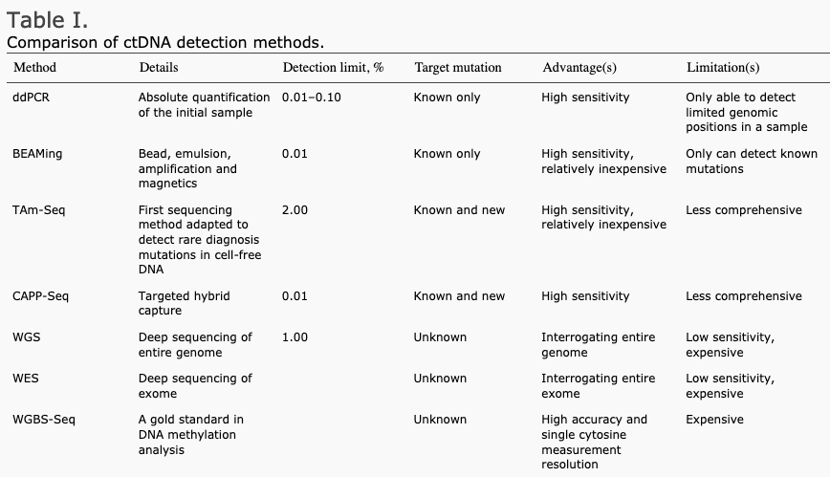
ctDNA study - sequencing
https://doi.org/10.3892/ol.2018.9794

Slide 22
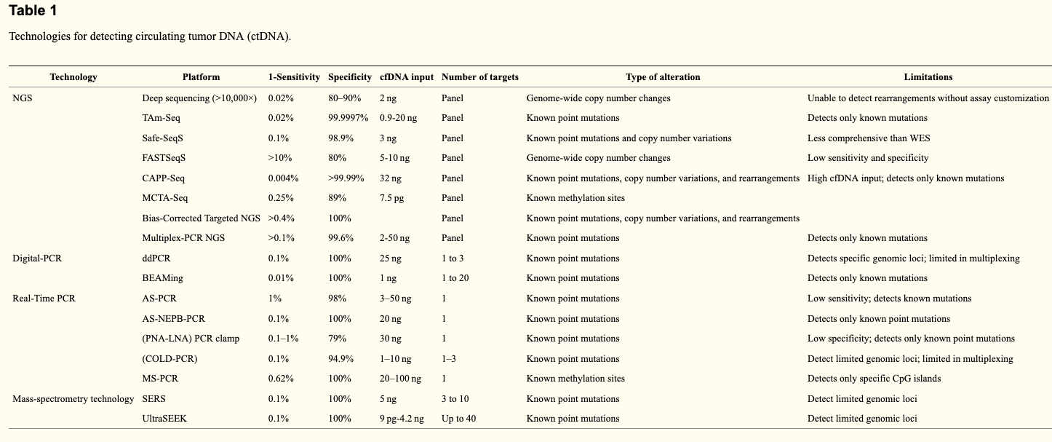
ctDNA study - sequencing
https://doi.org/10.1016/j.csbj.2018.10.002

Slide 23
RNAseq - Aim
Investigate expression patterns in canine mammary carcinomas
Hormonal receptors
Expression patterns
Compare different tumor types
Only carcinomas – maybe subtypes
Compare with somatic variation found in T/N
Pathway analysis
Notes:
Subclones – mismatch between sample from tumor and ctDNA
RNA seq – gene expression in WBC isn’t really comparable to mammary tissue and even if I had ”normal” mammary tissue, it probably wouldn’t be normal anyway, also, hormonal influence. Perhaps making a panel from young bitches, before hormones have affected the tissue too much.

Slide 24
RNAseq - Limitations
No normal sample from the same tissue for comparison
Hormonal influence at sample time
Solutions
Normal mammary tissue
Same dog -> likely no normal mammary tissue
Microdissection?
Other dogs -> panel of normal expression
Ethics of sampling healthy dogs (biopsy/FNA)
Young dogs probably needed due to hormonal influence over time
Notes:
Subclones – mismatch between sample from tumor and ctDNA
RNA seq – gene expression in WBC isn’t really comparable to mammary tissue and even if I had ”normal” mammary tissue, it probably wouldn’t be normal anyway, also, hormonal influence. Perhaps making a panel from young bitches, before hormones have affected the tissue too much.
Preferably before 3. heat, but should not be puppy.

Slide 25
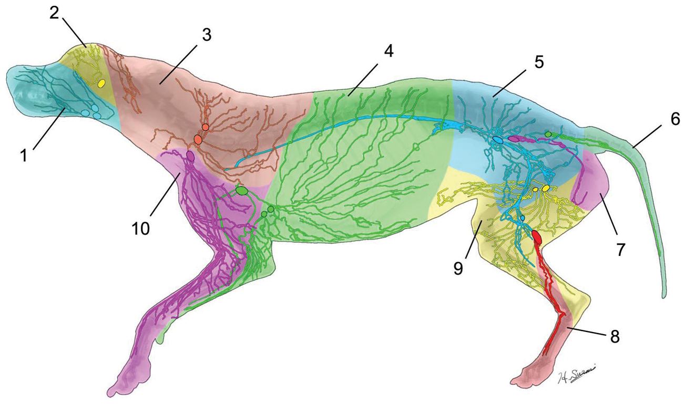
Clinical challenges Staging
Notes:
Staging
Why does it matter?
When treating cancer the treament dose is important – that means how much to remove and whether or not to follow up with other therapy such as chemotherapy.
In order to decide on treatment, you need to know where the cancer is. If it has spread to lymph nodes, it will not be sufficient to remove the tumor. However this is complicated by several factors. One is that the metastasis need to be present where we look and have a certain size.
For lymph nodes we have 2 main issues. The unpredictable drainage pattern – and size/placement of lymph nodes and the number of metastatic cells. Even if you find the correct lymph node, you might still miss the cancer cells.
For distant metastasis the issue is mostly an issue of size of metastasis, a few cells won’t show up on a CT.
Treatment dose
Surgical dose
Adjuvant therapy

Slide 26
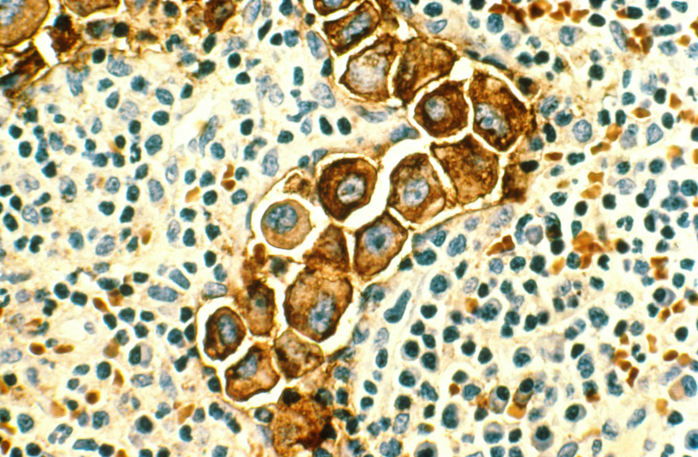
Clinical challenges Staging
Lymph node metastasis
Notes:
Staging
Why does it matter?
When treating cancer the treament dose is important – that means how much to remove and whether or not to follow up with other therapy such as chemotherapy.
In order to decide on treatment, you need to know where the cancer is. If it has spread to lymph nodes, it will not be sufficient to remove the tumor. However this is complicated by several factors. One is that the metastasis need to be present where we look and have a certain size.
For lymph nodes we have 2 main issues. The unpredictable drainage pattern – and size/placement of lymph nodes and the number of metastatic cells. Even if you find the correct lymph node, you might still miss the cancer cells.
For distant metastasis the issue is mostly an issue of size of metastasis, a few cells won’t show up on a CT.
Treatment dose
Surgical dose
Adjuvant therapy

